Slide 1
Program Name goes here
Link to github Repository: GitHub
Links to trello board / project management tools: Trello
You MUST provide evidence showing how the problem has been decomposed, how the components have been developed and trialled, and of how they have been assembled and tested to create a final, working outcome.

Slide 2
Relevant Implications
Explain the relevant implications here. Please watch this video to learn how to do this.
Notes:
Explain the relevant implications here. Then as you work, develop your code, discuss how the implications are being met.

Slide 3
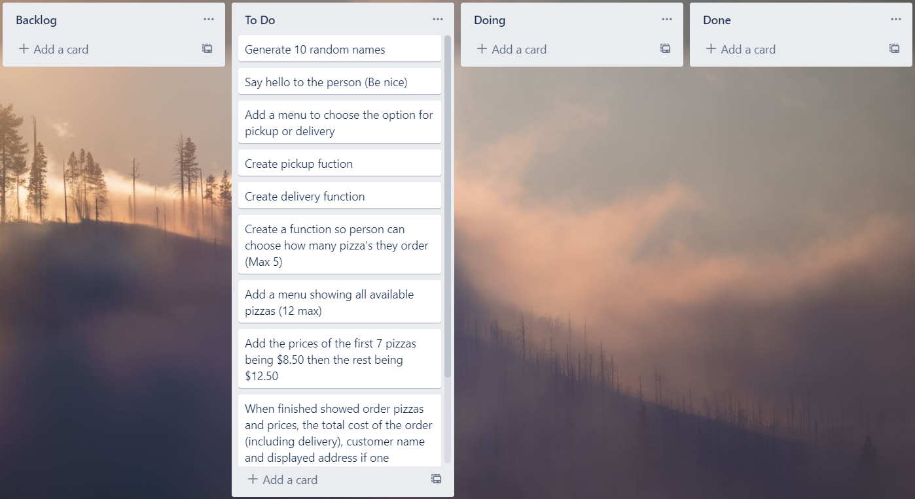
Decomposition
Paste screenshots of your initial Trello board / task decomposition on this slide. If you have a long list, you might need to break it up into several columns. Delete this instruction when you are done.
Notes:
Paste screenshots of your initial Trello board / task decomposition on this slide. If you have a long list, you might need to break it up into several columns. Delete this instruction when you are done.

Slide 4
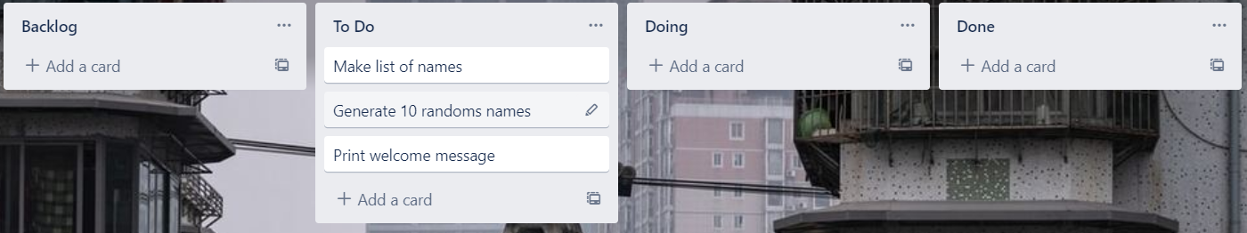
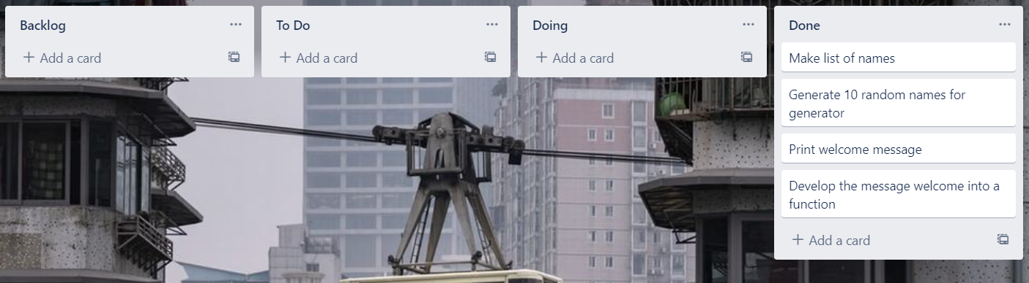
Component 1 (Trello screenshot)
Version 1
Version 2

Slide 5
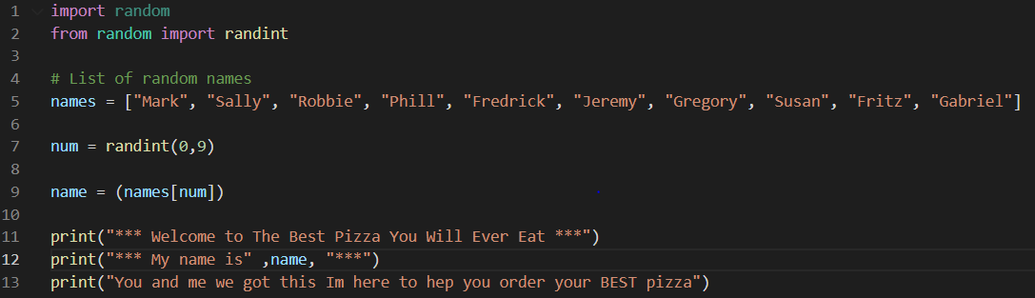
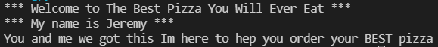
Component 1 - Test Plan (?and screenshot)
Test Case | Expected Values
Run Program | Print Welcome Message With Random Name

Slide 6
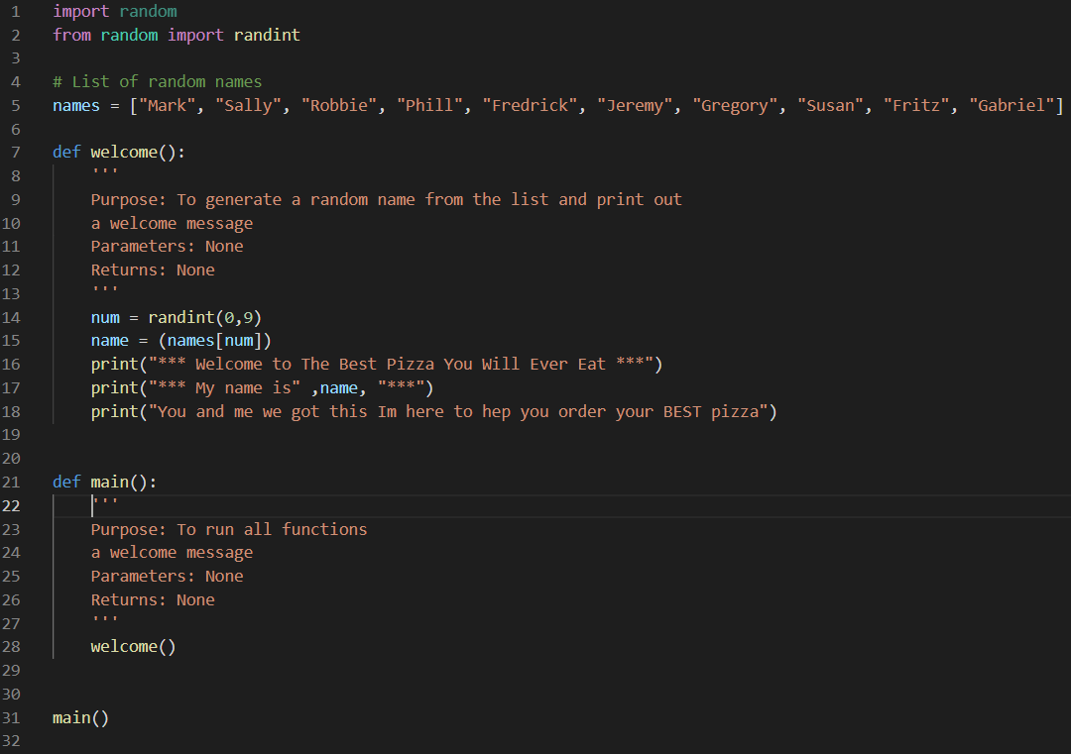
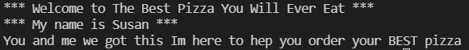
Component 1 version 2 - Test Plan (?and screenshot)
Test Case | Expected Values
Run Program | Main and Welcome run correctly. Welcome message prints with random name

Slide 7
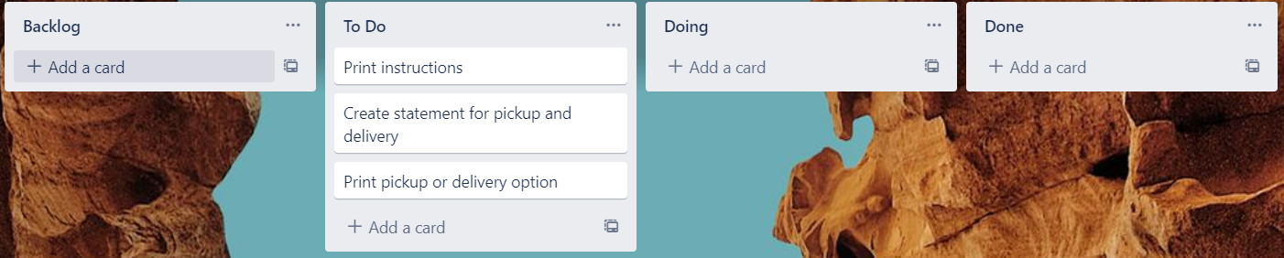
Component 2 (Trello screenshot)
Version 1
Version 2

Slide 8
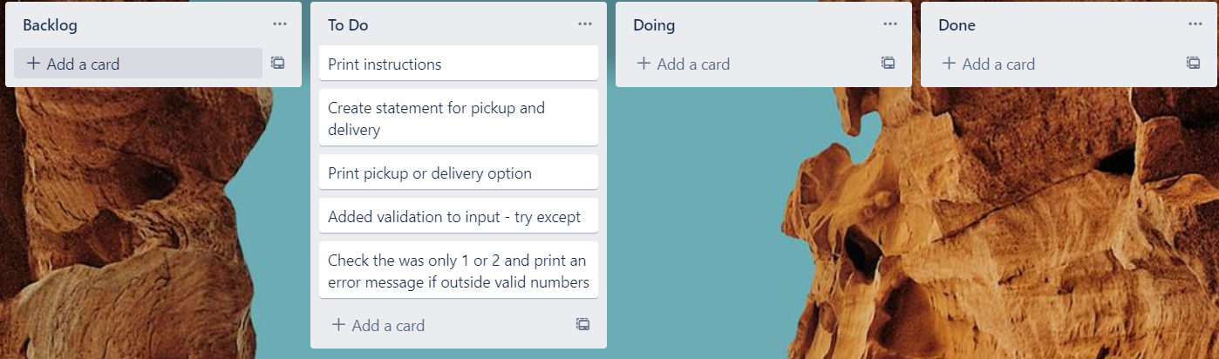
Component 2 version 2 (Trello screenshot)
Version 1
Version 2

Slide 9
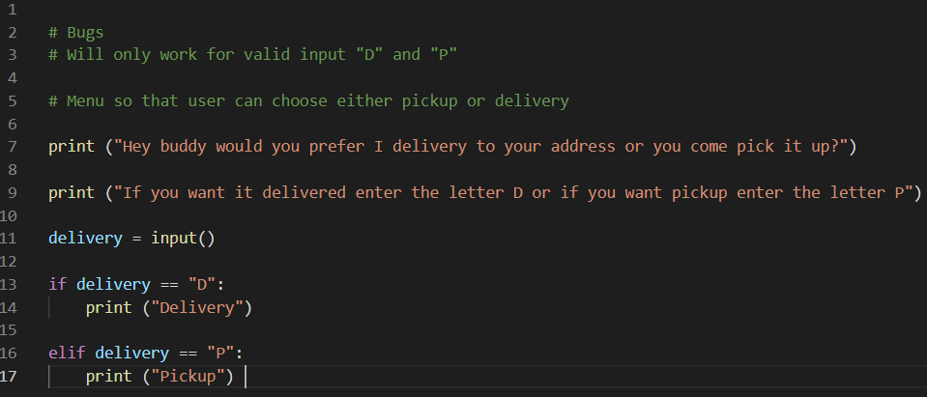
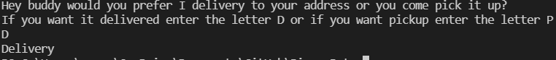
Component 2 - Test Plan (?and screenshot)
Test Case | Expected Values
Run Program | Ability to type D or P for pickup or delivery and then print messages based of input

Slide 10
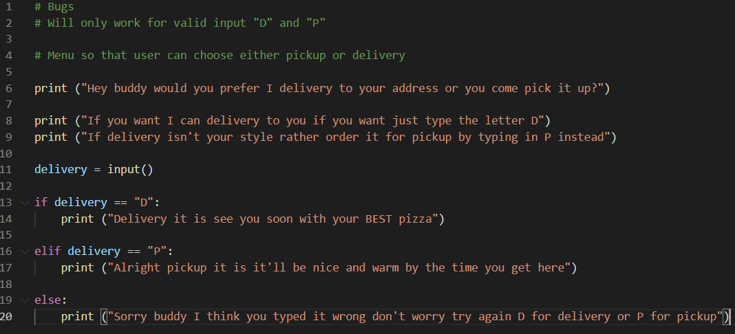
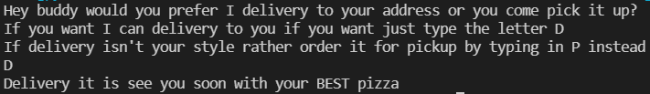
Component 2 version 2 - Test Plan (?and screenshot)
Test Case | Expected Values
Run Program | Able to order d for delivery or p for pickup with appropriate messages and another message if done incorrectely

Slide 11
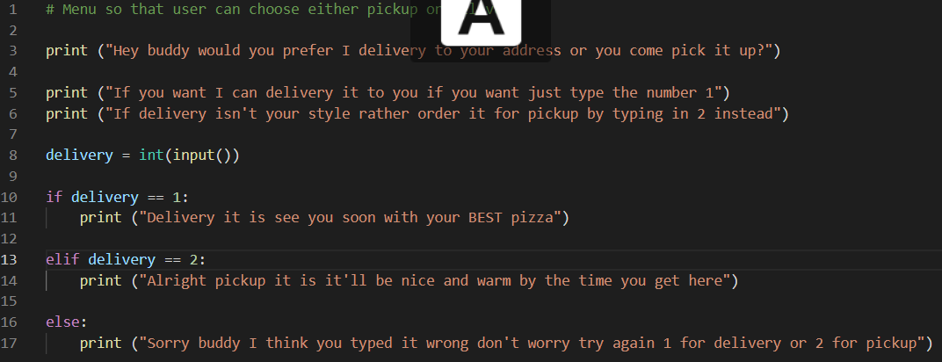
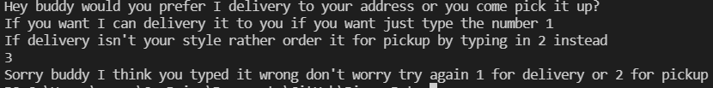
Component 2 version 3 - Test Plan (?and screenshot)
Test Case | Expected Values
Run Program | Able to order 1 for delivery or 2 for pickup rather then D or P

Slide 12
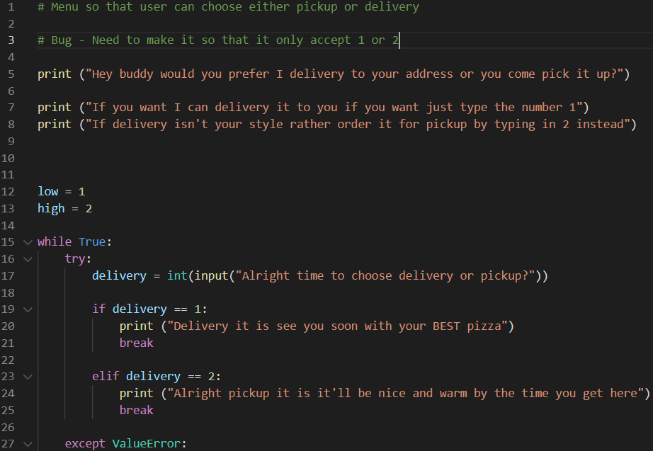
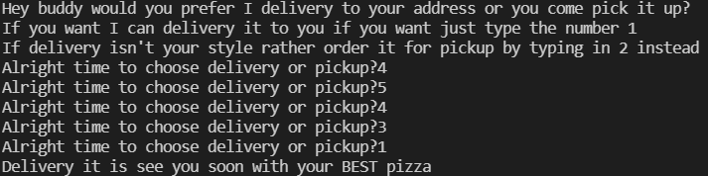
Component 2 version 4 - Test Plan (?and screenshot)
Test Case | Expected Values
Run Program | Can enter 1 for delivery or 2 for pickup, invalid response means error message but enter number other then 1 or 2 doesn't work

Slide 13
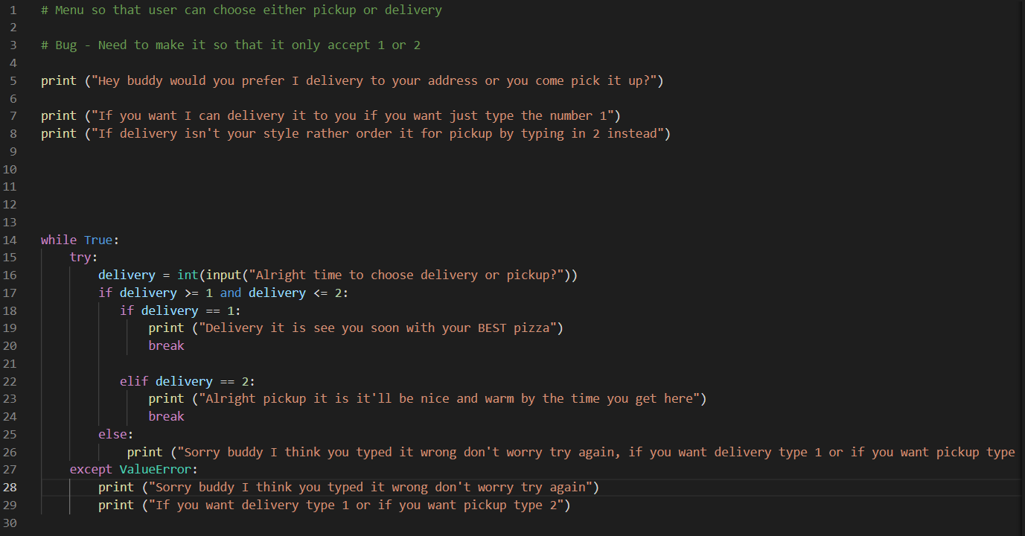
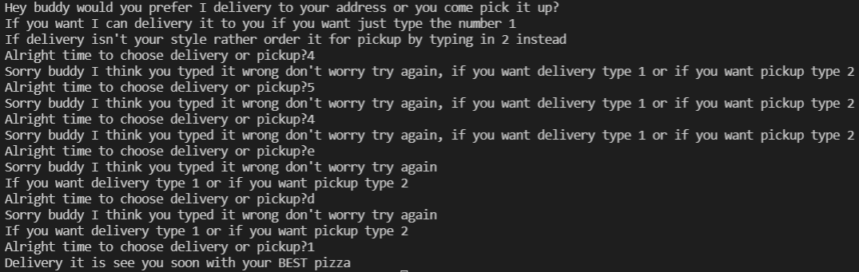
Component 2 version 5 - Test Plan (?and screenshot)
Test Case | Expected Values
Run Program | Can enter 1 for delivery or 2 for pickup, invalid response means error message and when you enter number other then 1 or 2 pops up with same error message

Slide 14
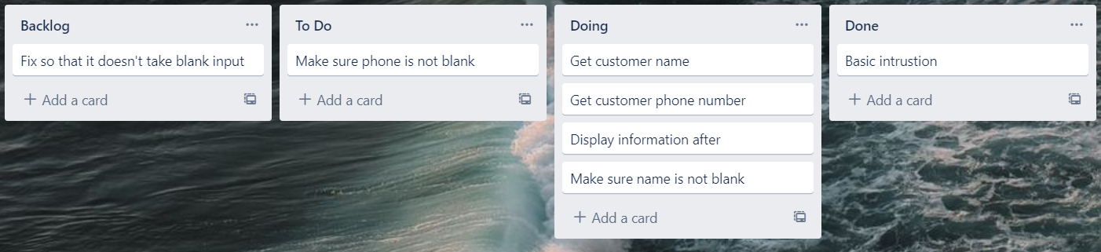
Component 3 (Trello screenshot)

Slide 15
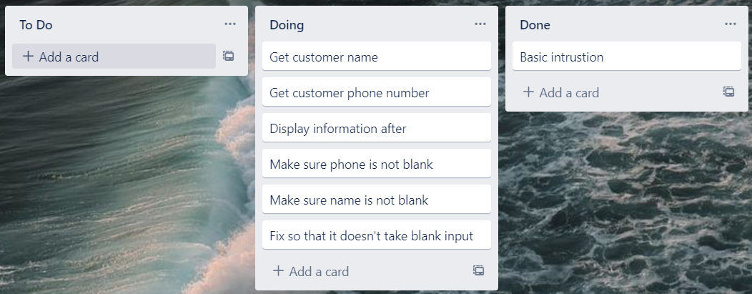
Component 3 version 2 (Trello screenshot)

Slide 16
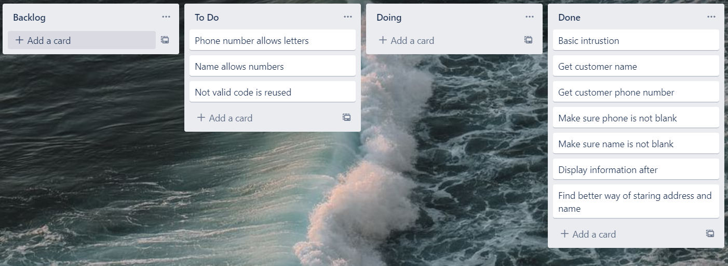
Component 3 version 3 (Trello screenshot)

Slide 17
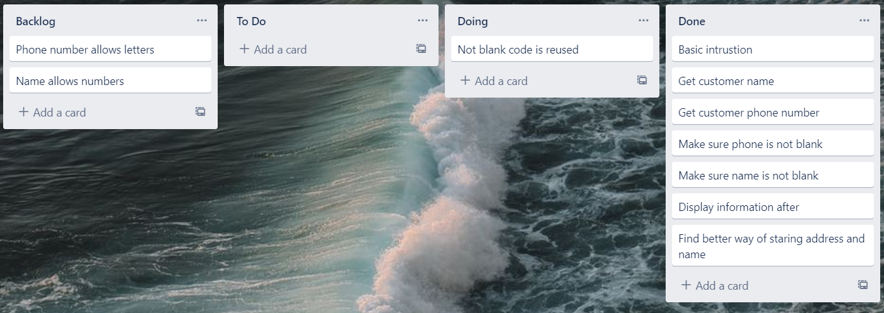
Component 3 version 4 (Trello screenshot)

Slide 18
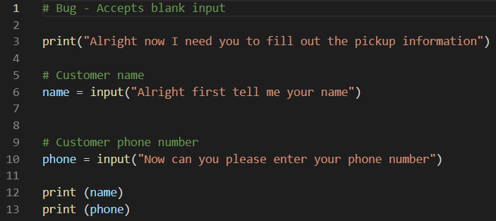
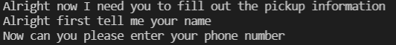
Component 3 - Test Plan (?and screenshot)
Test Case | Expected Values
Input name Input phone Left input blank | Printed name correctly Printed phone correctly Will accept blank input and will print blank

Slide 19
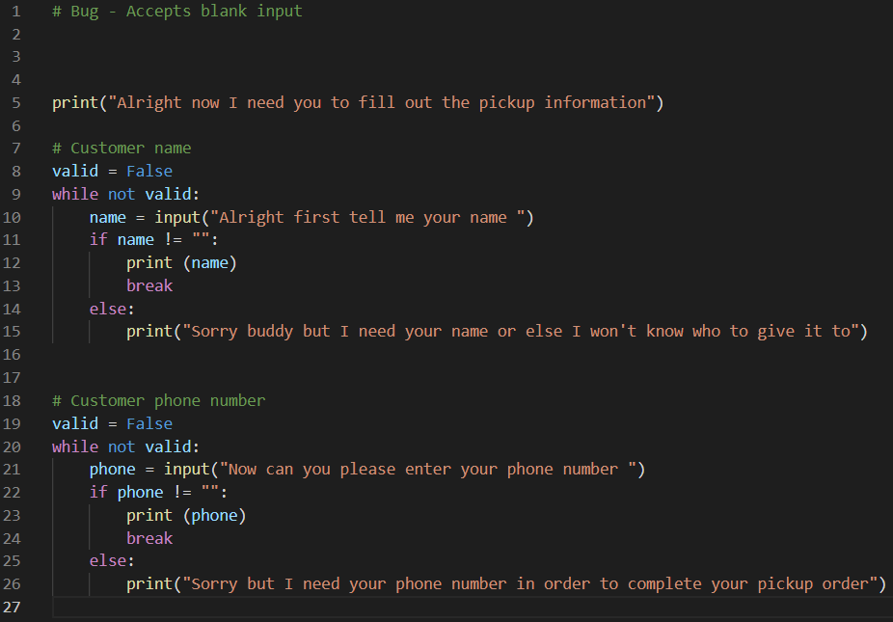
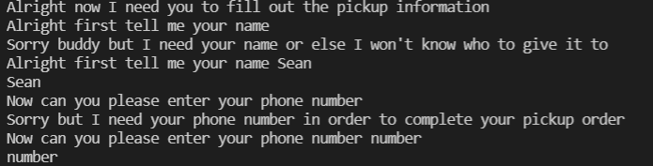
Component 3 version 2 - Test Plan (?and screenshot)
Test Case | Expected Values
Input name Input phone Left input blank | Printed name correctly Printed phone correctly Prints message saying can’t be blank

Slide 20
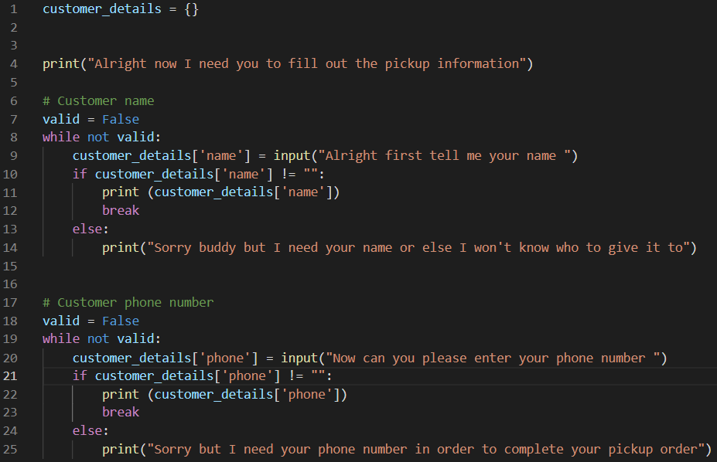
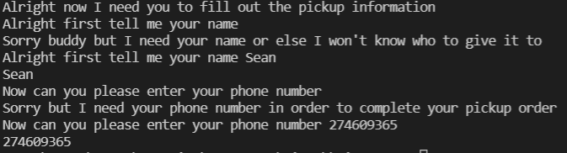
Component 3 version 3 - Test Plan (?and screenshot)
Test Case | Expected Values
Input name Input phone Left input blank | Printed name correctly Printed phone correctly Prints message saying can’t be blank

Slide 21
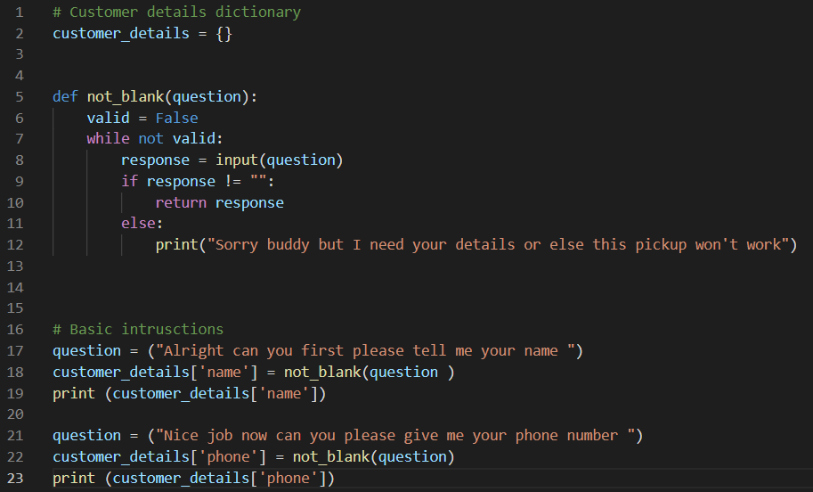
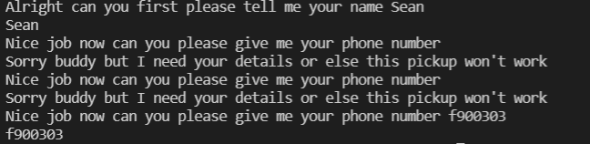
Component 3 version 4 - Test Plan (?and screenshot)
Test Case | Expected Values
Input name Input phone Left input blank | Printed name correctly Printed phone correctly Prints message saying can’t be blank

Slide 22
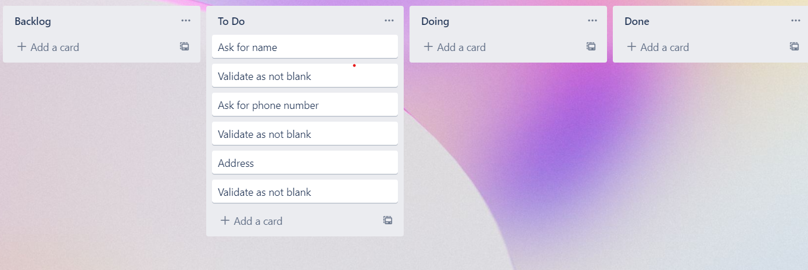
Component 4 (Trello screenshot)

Slide 23
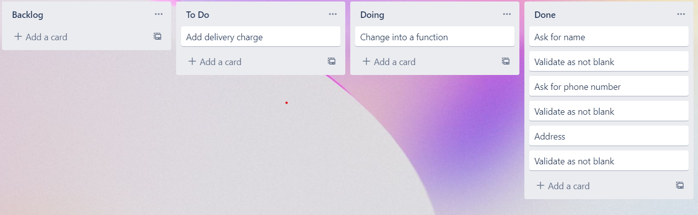
Component 4 version 2 (Trello screenshot)

Slide 24
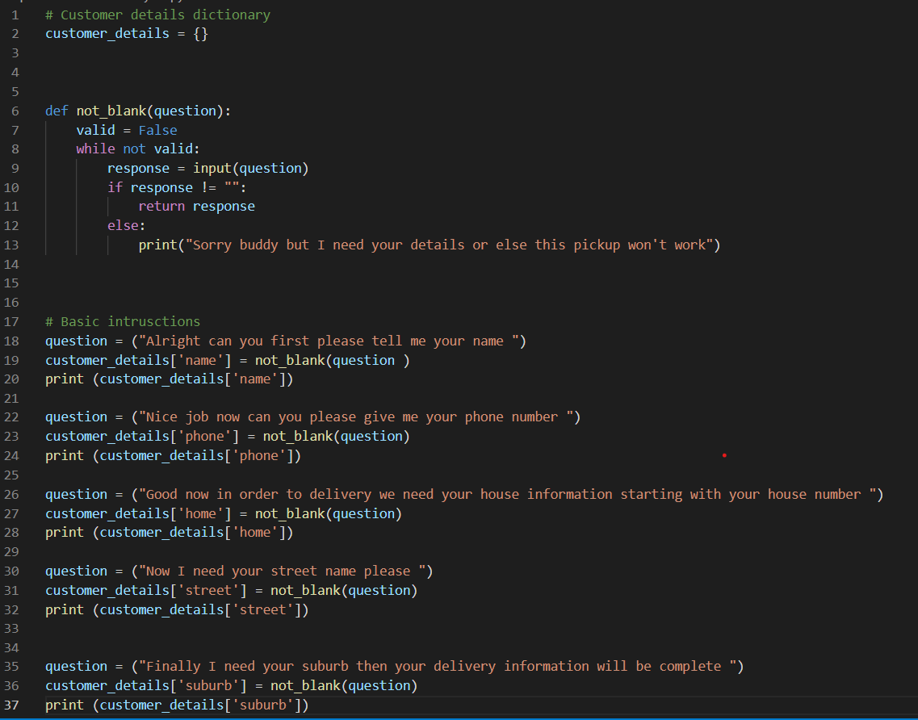
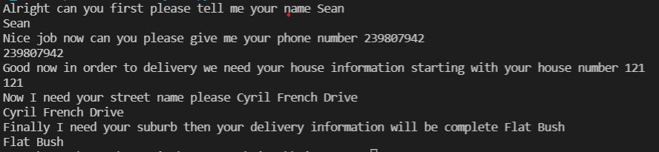
Component 4 version 1 - Test Plan (?and screenshot)
Test Case | Expected Values
Input name Input phone number Input home number Street number Suburb name Left input blank | Printed name correctly Printed phone number Accepted blank and printed blank input Printed street name Printed suburb name Asked for input again

Slide 25
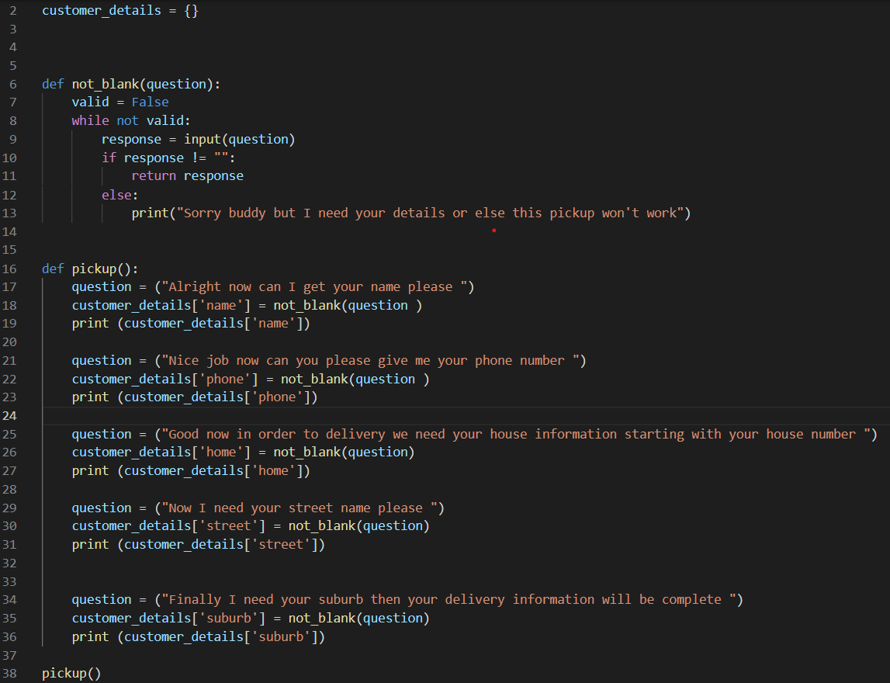
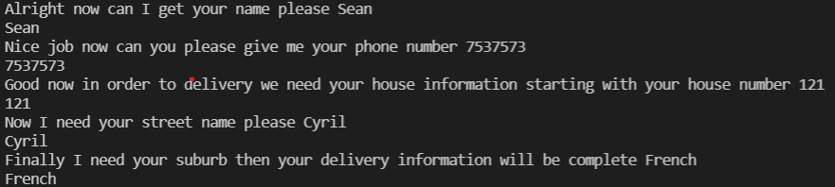
Component 4 version 2 - Test Plan (?and screenshot)
Test Case | Expected Values
Input name Input phone number Input home number Street number Suburb name Left input blank | Printed name correctly Printed phone number Printed house number Printed street name Printed suburb name Asked for input again

Slide 26
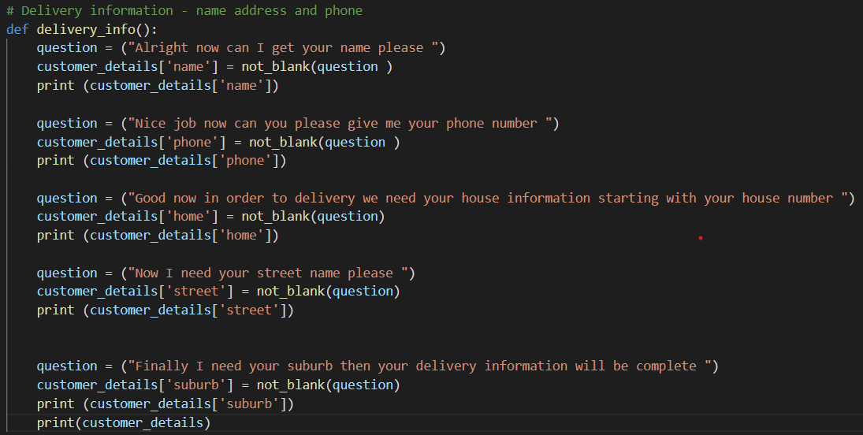
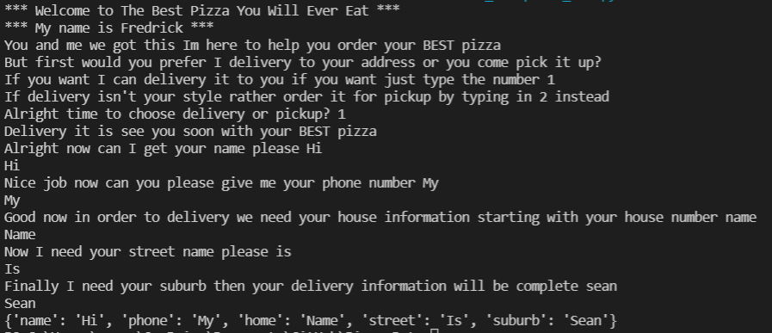
Component 4 version 3 - Test Plan (?and screenshot)
Test Case | Expected Values
Input name Input phone number Input home number Street number Suburb name Left input blank | Printed name correctly Printed phone number Printed house number Printed street name Printed suburb name Asked for input again

Slide 27
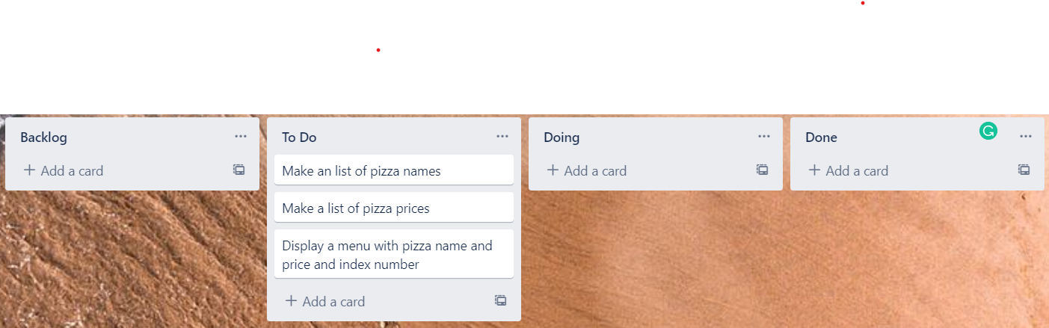
Component 5 (Trello screenshot)

Slide 28
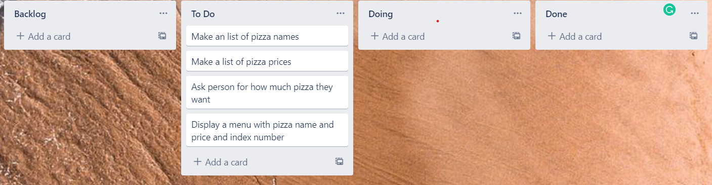
Component 5 version 2 (Trello screenshot)

Slide 29
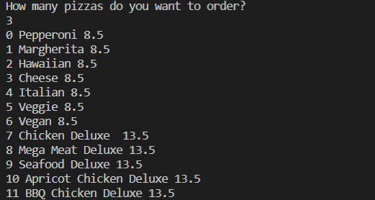
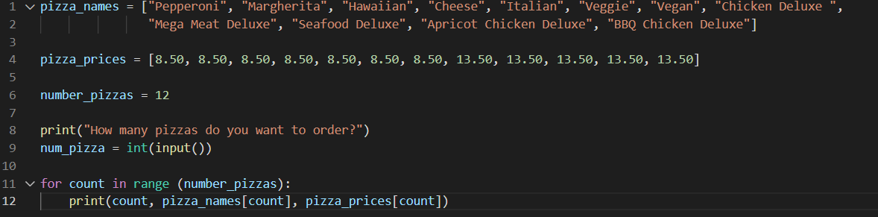
Component 5 version 1 - Test Plan (?and screenshot)
Test Case | Expected Values
Run file | Printed a list with index number, pizzas and prices

Slide 30
Version Control Evidence
Your version control evidence should go here. This could be in the form of annotated screenshots which show you you managed this process or you could make a brief screencast explaining how you implemented version control.
Notes:
Your version control evidence should go here. This could be in the form of annotated screenshots which show you you managed this process or you could make a brief screencast explaining how you implemented version control.

Slide 31
Discusses how the information from planning, testing and trialling of components assisted in the development of a high-quality outcome
Notes:
Discusses how the information from planning, testing and trialling of components assisted in the development of a high-quality outcome

